Slide 1
2018 Farm Bill
Making the ARC/PLC Decision
Mykel Taylor | Robin Reid | Dan O’Brien| Monte Vandeveer| Rich Llewelyn
Kansas State University Agricultural Economics
Check out our WEB page at http://www.AgManager.info
Copyright 2019, All Rights Reserved
This information is based on our understanding of the 2018 Farm Bill. This information is intended for educational purposes only. Keep checking www.AgManager.info for the latest information
Notes:
Feel free to take out our names and add your own!

Slide 2
2018 Farm Bill Titles
Title I: Commodities
Title II: Conservation
Title III: Trade
Title IV: Nutrition
Title V: Credit
Title VI: Rural Development
Title VII: Research, Education, and Related Matters
Title VIII: Forestry
Title IX: Energy
Title X: Horticulture
Title XI: Crop Insurance
Title XII: Miscellaneous
Notes:
Commodities: Farm programs, marketing loans, sugar, dairy
Conservation: CRP, EQIP (environ. Quality incentives program), conservation easements
Trade: Food for Peace Act, Ag Trade Act,
Nutrition: SNAP (supplemental nutrition assistance program)
Credit: Farm ownership loans, Farm operating loans, Emergency loans, Beginning farmer program
Rural development: Rural infrastructure and community development loans and grants, Value-added agriculture and business development grants
Energy: Renewable energy loan and grant program, Biomass crop assistance program, Biobased product marketing and manufacturing assistance programs (including advanced biofuels)
Miscellaneous: Livestock, socially disadvantaged and limited resource producers, etc.

Slide 3
Farm Bill Budget
Projected Outlays, FY2019-2028
Source: Congressional Research Service and Congressional Budget Office
Notes:
This is just to emphasize that even though there are many titles, 77% of the funding goes to nutrition programs.
Crop Insurance, Conservation, and Commodities are the main titles that assist farmers, which collectively make up 23% of the expected expenditures.
Other programs are only a very small fraction (0.49%) of the projected budget

Slide 4
Decisions to be made…
TENANT OR BOTH IF SHARED RISK
  Elect a Program
Decision for each Commodity (85% of base)
All Commodities on Farm (65% of total base)
PRICE LOSS COVERAGE
(PLC)
AGRICULTURAL RISK COVERAGE
- County Level -
(ARC-CO)
AGRICULTURAL RISK COVERAGE
- Individual Level -
(ARC-IC)
Supplemental Coverage Option
(SCO)
Purchased on Planted Acres
Notes:
PLC and ARC-CO can be selected commodity by commodity (i.e. Corn can go in PLC and Wheat in ARC-CO, etc). ARC-IC takes all commodities and lumps them together to determine a loss, therefore the whole farm has to sign up for ARC-IC.
Program selection is made by FSA farm number. So a producer with multiple farm numbers can make different decisions on each farm.
You have the OPTION to purchase SCO if you are not enrolled in an ARC program.
These are the same programs that were available in the 2014 Farm Bill. Minor changes have been made to the programs, but overall the structure of the programs are the same.

Slide 5
Brief Review of ARC-CO and PLC Design
ARC-CO – Low revenue program
  Triggers when revenue is below 86% of county benchmark: set by last 5 years (with 1 lag year)of national Marketing Year Average prices and county yields
  Payments determined on county-by-county basis, subject to a 10% payment cap.
PLC – Low price program
  Triggers when national Marketing Year Average price below the reference price for the crop.
  Payments determined by a national price, and paid on farm base acres and program yields.
  Subject to a much higher cap
  Also provided the option for SCO.
Notes:
ARC-CO: You can think of this program as a revenue based crop insurance program that is tied to national prices and county yields, with a 14% deductible. However the 10% payment cap makes these payment max out very quickly. They only cover a small amount of revenue loss in the event of low county yields or low national prices.
PLC:
There is no yield protection in this program. It pays on your established yield with FSA.
The cap is the loan rate for each commodity. So the national MYA price cannot fall below the loan rate or payments will be based on the loan rate. Likely if this would occur, most farms will hit their $125,000 limit anyway.
SCO=Supplemental Coverage option on your individual crop insurance. We will talk more about that later.

Slide 6
Percent of Farms that Made an ARC/PLC Election
Nationally by Crop
Source: USDA (http://www.fsa.usda.gov/programs-and-services/arcplc_program)
Notes:
In the 2014 Farm Bill, national most all corn and soybean base went into ARC-CO.
Grain sorghum was split between PLC and ARC county (if you recall during the election period, China was buying grain sorghum instead of corn because of the GMO issue and it temporarily inflated grain sorghum prices which made some producers switch their election to ARC
Nationally wheat election was about 1/3 PLC and 1/3 ARC-CO
The ARC-IC program was very unpopular (because it only pays on 65% of base acres and all commodities on the farm are combined together)

Slide 7
Percent of Farms that made an ARC/PLC election
Kansas by Crop
Source: USDA (http://www.fsa.usda.gov/programs-and-services/arcplc_program)
Notes:
In Kansas, most corn and soybeans went ARC-CO as they did nationally
Grain sorghum was again split
Wheat in Kansas favored ARC-CO more than nationally. This was because during the election period in 2015 it was already known that there would be ARC-CO payments on wheat in many KS counties and no PLC payment. In hindsight, PLC was the better choice in most counties since the prices fell so drastically (extremely high yields for the 2015 crop which took years to use up)

Slide 8
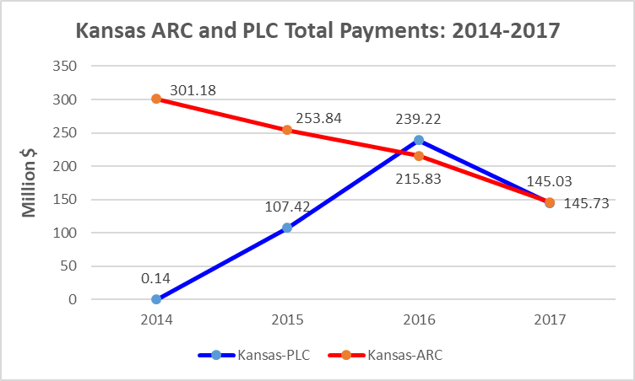
Notes:
Total payments in the ARC program well exceeded payment in the PLC program in Kansas for the first 2 years. After than, PLC payments exceeded ARC payments in 2016 and were near equal in 2017.
This is because the ARC-county guarantee declined because of low prices, yields were good in most counties which eliminated ARC-CO payments, price was low so PLC paid large amounts for grain sorghum and wheat.
2018 payment will be made in Oct. of 2019, so data is not yet available.

Slide 9
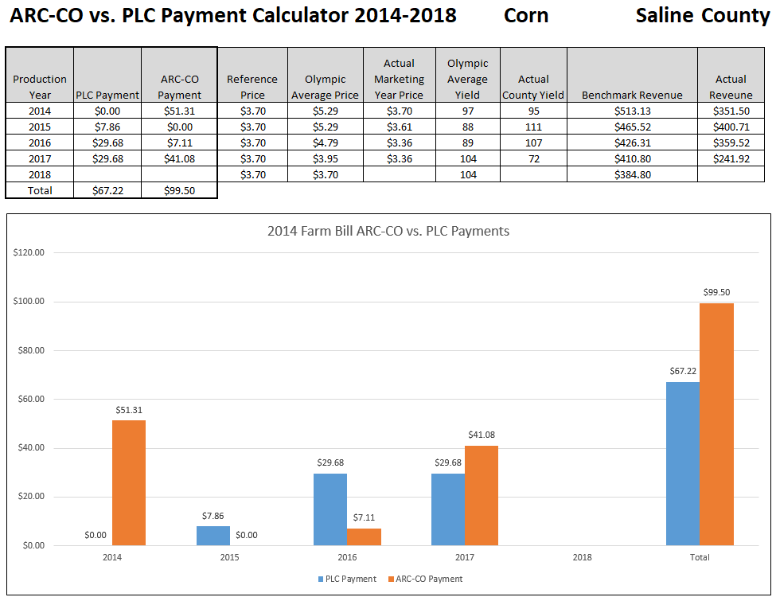
Table of annual and total results
For Saline county corn, ARC-CO paid $32.28 more than PLC for 2014-2017. Both had three payments.
Graph of annual and total results
Notes:
Replace underlying table with a screen shot of your own county. You may need multiple slides for each commodity if you had an irrigation designation. Update the text to reflect your county’s values as well.
This spreadsheet tool is available here: http://agmanager.info/ag-policy/2018-farm-bill/2014-farm-bill-arc-co-vs-plc-comparison-tool

Slide 10
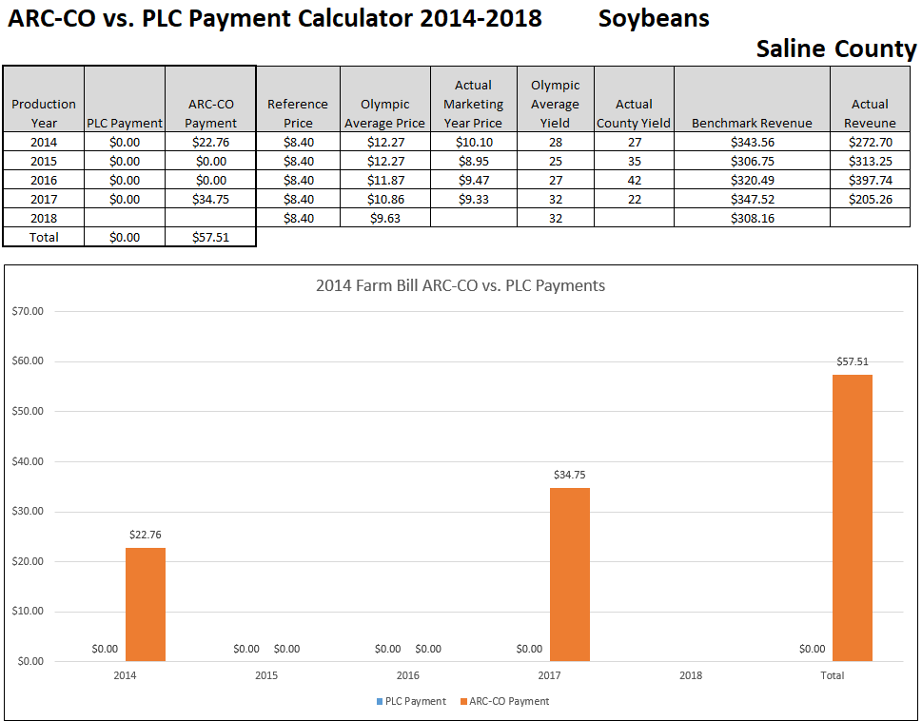
Soybeans in Saline county had 2 ARC payments, no PLC payments, and $57.51 more for ARC 2014-2017.
Notes:
Replace underlying table with a screen shot of your own county. You may need multiple slides for each commodity if you had an irrigation designation. Update the text to reflect your county’s values as well.
This spreadsheet tool is available here: http://agmanager.info/ag-policy/2018-farm-bill/2014-farm-bill-arc-co-vs-plc-comparison-tool

Slide 11
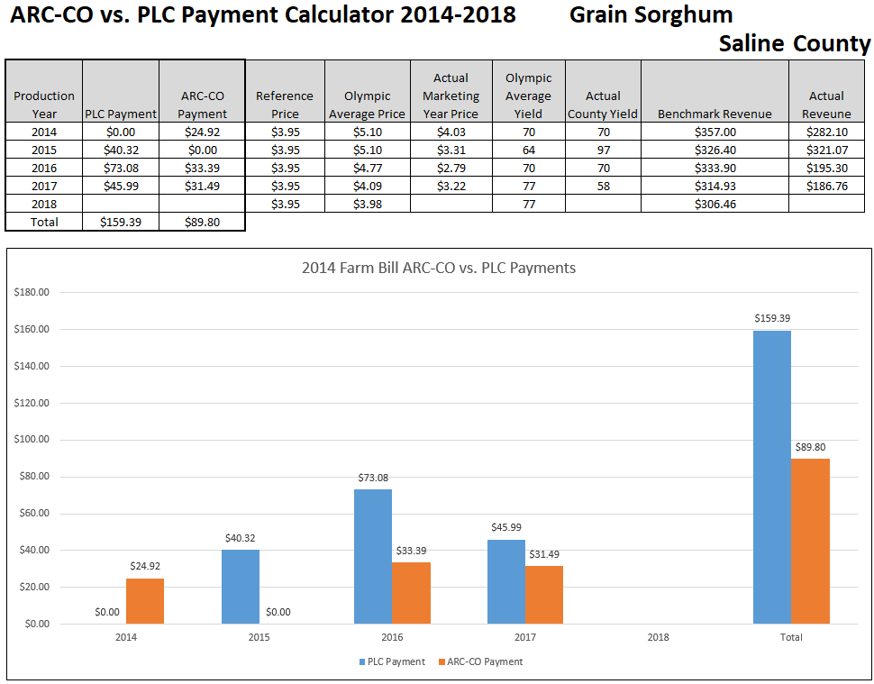
PLC for grain sorghum in Saline county had 3 payments, ARC had 3 payments, but PLC totaled $69.59 more than ARC for 2014-2017.
Notes:
Replace underlying table with a screen shot of your own county. You may need multiple slides for each commodity if you had an irrigation designation. Update the text to reflect your county’s values as well.
This spreadsheet tool is available here: http://agmanager.info/ag-policy/2018-farm-bill/2014-farm-bill-arc-co-vs-plc-comparison-tool

Slide 12
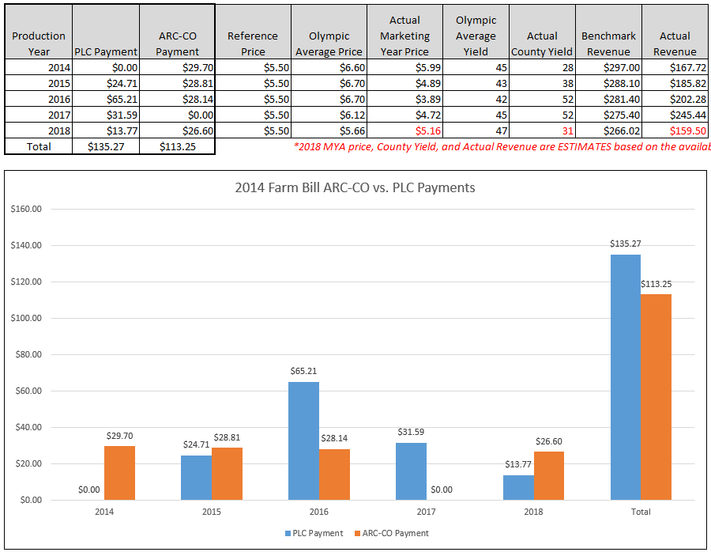
Wheat in Saline county had 4 PLC payments and 4 ARC payments. PLC totaled $135.27 more than ARC for 2014-2018. Compare the first two years (ARC better) vs. the last two years (PLC better).
Notes:
Replace underlying table with a screen shot of your own county. You may need multiple slides for each commodity if you had an irrigation designation. Update the text to reflect your county’s values as well.
This spreadsheet tool is available here: http://agmanager.info/ag-policy/2018-farm-bill/2014-farm-bill-arc-co-vs-plc-comparison-tool

Slide 13
What we did last time around…
Farmers with more experience picked PLC
  More experience with low price scenarios than newer farmers who just came off a run of very good incomes
Farmers with higher crop insurance coverage levels preferred ARC
  Did not see advantage to SCO option under PLC
High levels of uncertainty pushed people toward PLC
  Simpler program and more attractive for people who “just weren’t sure” what program to pick
Current information on payouts of ARC in 2014 in certain counties pushed people toward ARC
  Bird-in-hand attitude versus looking at the entire 5-year period
Notes:
This information came from survey’s we did at our 2014 Farm Bill meetings and actual election data.

Slide 14
What do we expect this time around?
Tendency to look backwards and try to fix our (perceived) mistakes
But we have to keep looking forward and using the best information we have to determine which program is the best fit
Risk management versus highest payout
  Is your farm more susceptible to catastrophic price scenario or shallow loss?
MFP payments will be supplementing the ARC/PLC payments and may end up being higher for some people
  Do not depend on MFP in the long run…
Notes:
MFP=Market Facilitation Payments
These were made in 2018 because of the trade-war with China and the collapse of the soybean market. They were announced to happen again in 2019 but instead of being paid per commodity there will be a base rate in each county and paid to farmers based on 2019 planted acres. They will be paid in 3 installments IF the trade war continues and market prices remain low. However, with prevented planting this spring commodity prices have increased some. It is not a sure thing that much will be received in 2019 and likely no MFP payments will occur in 2020.

Slide 15
Decisions to be made…
Each farm will choose a farm program to enroll in starting Sept. 1st, 2019
If you do not enroll, your farm will default to the decision made for the last farm bill and NO payment will be received on the 2019 crop
The first payment of the new Farm Bill will be made in Oct. 2020
  This will be on the crops harvested in 2019
Notes:
We do not know how long enrollment will be open for. It will likely be at least a couple months.
It takes a full year to get a “Marketing year Price” for each commodity, therefore there is a big lag between when you harvest the crop to when you get the payment on it. For wheat it’s a year and a half lag; fall harvested crops are a year lag

Slide 16
PLC - ARC Producer Election
The election between ARC/PLC is one of the key changes in the 2018 Farm Bill
  The initial election will be in 2019 for the first 2 years of the planned 5 year program, i.e., MY 2019/20 & MY 2020/21
  Beginning with the 2021 crop year, producers will be allowed to change their ARC/PLC program elections annually
Notes:
This will allow producers to select annually the program that is projected to pay the most of offer the best risk management
This really is the game-changer of this farm bill and takes some of the pressure off to try to forecast prices in making a 5-year decision, as farmer’s had to do in the 2014 Farm Bill

Slide 17
Timeline
 | Beginning | End
2019 Enrollment (Elect programs for 2019 & 2020) | September 3rd,2019 | March 15th,2020
2020 Enrollment | October 1st, 2019 | June 30th, 2020
2020 Yield Update | October 1st, 2019 | September 30th, 2020
2019 ARC/PLC Payments Received | October 2020
Future years (2021-2023) will have an Oct. 1st-March 15th enrollment period
Notes:
Future years (2021-2023) will have an Oct. 1st-March 15th enrollment period

Slide 18
Unassigned Base Acres
Farmers-ranchers who planted their entire farm to grass and pasture all years from 2009-2017 will have their base “unassigned”.
Question: What is NOT grass and pasture?
  All program crops.
  Alfalfa
  Farmers who planted base acres to wheat or oats and harvested it as hay or pasture are considered planted to a program crop.
  CRP is considered planted and not grass/pasture
  Farmers who planted triticale, brome, or similar forages for hay or grazing are in a “gray” area. What is the definition of “grass”? It will need to be interpreted by the Secretary.
  Base acres converted to grass hay or native grass pasture are NOT considered planted to a crop.
Notes:
Producers should already have received a letter from FSA if they have a GIF farm (Grass/Idle/Fallow)

Slide 19
Unassigned Base Acres
Farmers (ranchers) who have their base “unassigned” will continue have their acres considered “planted” to program crops during the life of this farm bill so it will maintain the base for future legislation.
These base acres will be “unassigned” from receiving commodity payments, but eligible for the Conservation Stewardship Program (CSP) grasslands program payment at a rate of $18/acre.
They will need to sign up for this NRCS program (not automatic) and address at least one resource concern

Slide 20
What Changed in PLC?
“Effective Reference Price” instead of just the statutory reference prices
Commodity | 2018 Farm Bill Statutory Price ($/bu) | Highest “Effective” Reference Price Possible (115% of Statute)
Wheat | 5.50 | 6.33
Corn | 3.70 | 4.26
Sorghum | 3.95 | 4.54
Soybeans | 8.40 | 9.66
Notes:
Some of this information will be presented by FSA during their presentation, so what we should focus on is what do these changes mean for the producer.
The lowest the price can go is the statutory price to set the price floor for PLC. The highest the price can go is 115% of the statutory price. It is determined by a formula of the last 5 year’s of national prices.
Because of the low prices in recent years, it is very unlikely that prices to set the PLC guarantee will be any higher than the statutory price. So the PLC program will pretty much be exactly like it was in the 2014 Farm Bill (using Statutory reference prices)

Slide 21
What Changed in PLC?
2. Payment Yield Update will again be offered by 2020
The 2020 update is intended to benefit farmers who sustained multiple years of losses during the 2008‐2012 crop years used to calculate the 2014 updated program yield.
Will use the farm’s yields from 2013-2017, excluding any years that the crop was not planted
Low yield years will be replaced by 75% of the county average yield from 2013-2017
The average farm yield over these years (after low yield replacement) will be multiplied by 90% and then by a “detrending” factor
**Don’t get caught up in the formula. FSA will run this for you. If the update is higher than your current established yield, UPDATE, even if in PLC
Notes:
The biggest thing to highlight here is that EVERYONE should take advantage of this update regardless of what program they choose. This was only offered again because of the multiple drought years during the years that were used in the 2014 Farm Bill. It is highly unlikely that this will be offered again in the next Farm Bill.

Slide 22
Changes made to ARC County
Increase the transitional yield plug to 80% from 70% used for the Olympic average yield calculation for ARC.
A trend yield adjustment, similar to crop insurance’s SCO trend adjustment, will be applied to ARC which will also increase the guarantee in many cases
County Yield
2015 | 100
2016 | 120
2017 | 80
2018 | 30
2019 | 110
Olympic Average | 96.7
What this means:
Low years in county yield history will be replaced by a higher number
This will bring the average up in some cases, raising the ARC-CO guaranteed revenue
Notes:
The trend adjustment will include more than just the last 5 years. It will either be positive or neutral (won’t decrease the yield guarantee)

Slide 23
Changes made to ARC County
ARC payments will be based on county where base acres are located rather than administrative county.
Prioritize RMA data in the calculation of county yields used for the ARC guarantee and actual yields.
Notes:
RMA data-Risk Management Agency (crop insurance) data

Slide 24
Changes made to ARC County
There will be a separate irrigated and non-irrigated yield ARC guarantee in more counties.
  Had to have 3 out of 5 years of RMA data for each practice (2013-2017)
  OR at least 10% of the crop in the county AND at least 5,000 acres each year from 2013-2017
The 5 year guarantee will have a “lag” year
  2019 Guarantee will include years 2013-2017
  2020 Guarantee will include years 2014-2018
Notes:
Irrigation designations in the last farm bill were made if 25% of the county fell into each practice (ex: at least 25% of the county’s corn was irrigated, then they got 2 separate ARC-CO guarantees)
Visit AgManager for a list of counties that have separate guarantees for the 2018 Farm Bill
The lag year allows FSA to put out ARC-CO guarantees for the next year more quickly (so producers have the information for the following enrollment year)
Because of all of these changes to ARC, it is definitely worth looking at what your county guarantee will be for 2019. In many cases it will be significantly higher than it was in 2018.

Slide 25
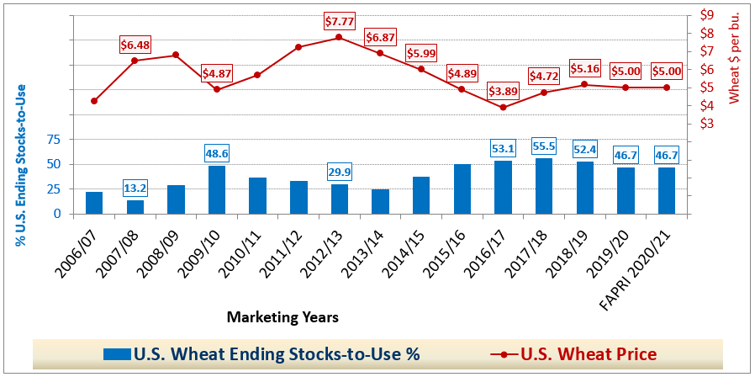

U.S. Wheat Ending Stocks & Prices
Notes:
Ending stocks on wheat are relatively high
The MYA price for wheat in the next two marketing years remains fairly low ($5.00)
At this rate PLC would be paying $0.50 per bushel

Slide 26
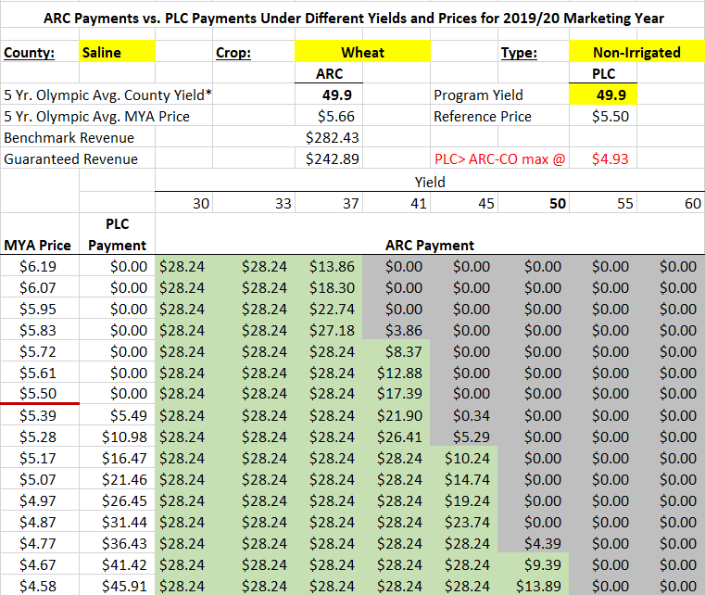
What program should I choose?
PLC payments will be made if the MYA price drops below $5.50
PLC payment will exceed ARC-CO payments at any yield level if price drops below $4.93
With an average yield (50 bushels), ARC-CO will not start paying until price falls below $4.77
If the county yield is lower than average, ARC-CO will pay at much higher prices BUT if the county yield is higher than average, it will take a large price loss to trigger any payment
ARC-CO maximum payment will be $28.24 per acre in 2019
Notes:
Use the “Trade-Off” spreadsheet under Agent Resources to get your county/crop. You may have to duplicate this slide if you have irrigated and dryland acres of each commodity.
Change the numbers in RED to reflect what the table is telling you for your own county.
Payments are listed on a per acre basis
Keep in mind that these payments will only be made on 85% of the base acres that you have in that commodity. There may also be a budget sequestration on these payments (likely 6.2%)
Also, the program yield (in yellow) is actually your farm’s own established yield with FSA. Producers can use this spreadsheet themselves off of AgManager and put in their own program yield to more accurately evaluate the trade-off for their farm

Slide 27
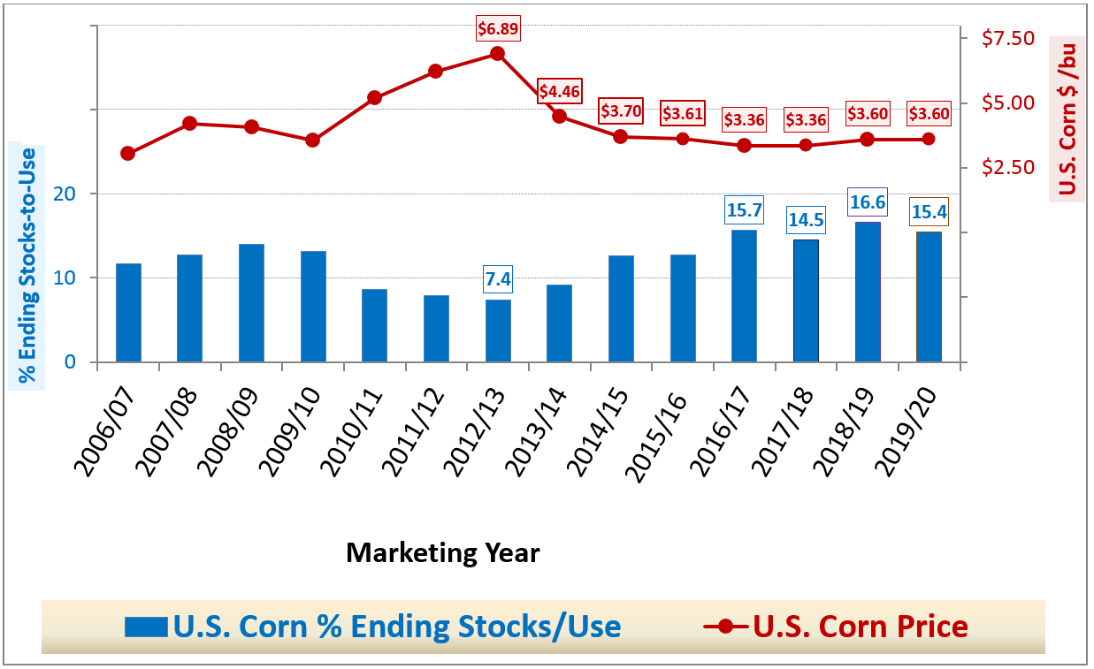
U.S. Corn % Stocks/Use vs Price$
Notes:
Stocks to use numbers are relatively high
Corn MYA price predicted to be fairly low ($3.60)
Small PLC payment at this price ($0.10)

Slide 28
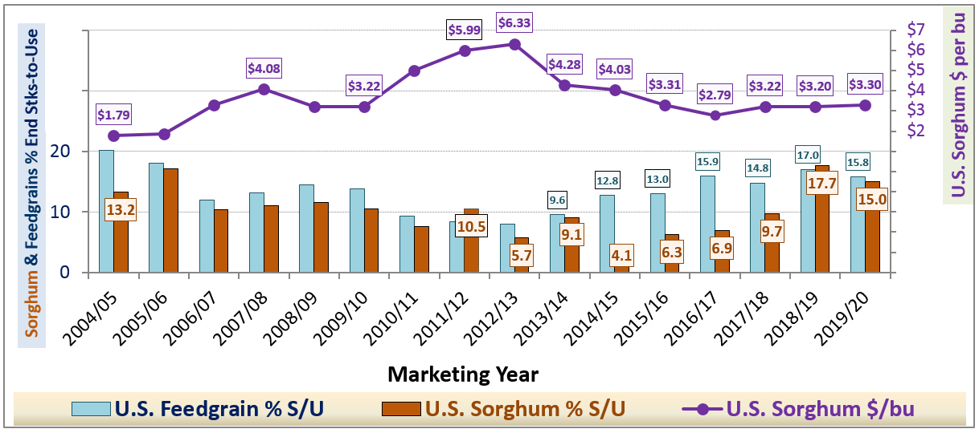
U.S. Sorghum % Stocks/Use vs Price$
Notes:
Like corn, sorghum stocks are also relatively high
$3.20 predicted MYA
PLC payment ($3.95-$3.70= $0.25 payment)

Slide 29
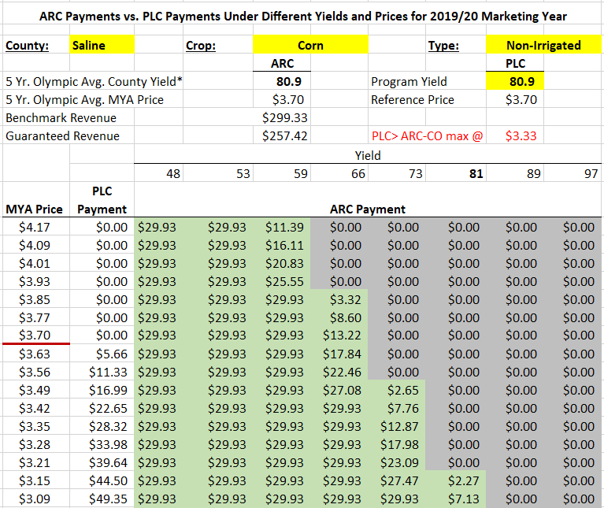
What program should I choose?
PLC payments will be made if the MYA price drops below $3.70
PLC payment will exceed ARC-CO payments at any yield level if price drops below $3.33
With an average yield (81 bushels), ARC-CO will not start paying until price falls below $3.15
If the county yield is lower than average, ARC-CO will pay at much higher prices BUT if the county yield is higher than average, it will take a large price loss to trigger any payment
ARC-CO maximum payment will be $29.93 per acre in 2019
Notes:
Use the “Trade-Off” spreadsheet under Agent Resources to get your county/crop. You may have to duplicate this slide if you have irrigated and dryland acres of each commodity.
Change the numbers in RED to reflect what the table is telling you for your own county.
Payments are listed on a per acre basis
Keep in mind that these payments will only be made on 85% of the base acres that you have in that commodity. There may also be a budget sequestration on these payments (likely 6.2%)
Also, the program yield (in yellow) is actually your farm’s own established yield with FSA. Producers can use this spreadsheet themselves off of AgManager and put in their own program yield to more accurately evaluate the trade-off for their farm

Slide 30
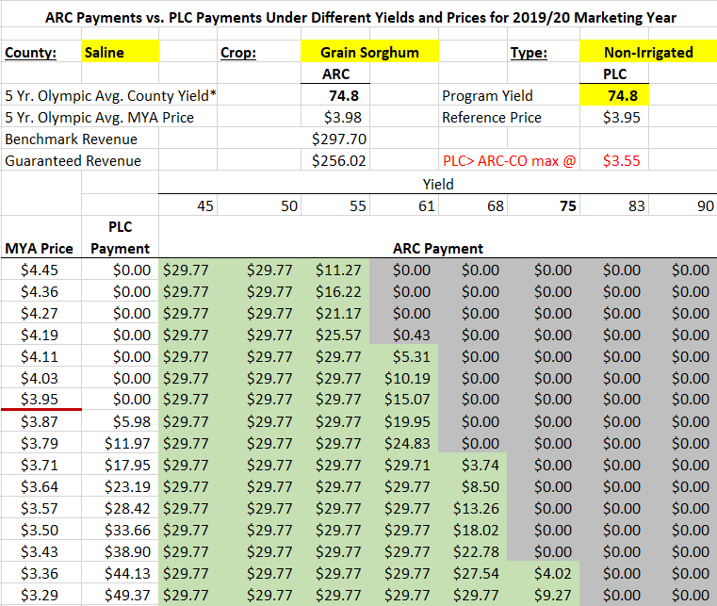
What program should I choose?
PLC payments will be made if the MYA price drops below $3.95
PLC payment will exceed ARC-CO payments at any yield level if price drops below $3.55
With an average yield (75 bushels), ARC-CO will not start paying until price falls below $3.36
If the county yield is lower than average, ARC-CO will pay at much higher prices BUT if the county yield is higher than average, it will take a large price loss to trigger any payment
ARC-CO maximum payment will be $29.77 per acre in 2019
Notes:
Use the “Trade-Off” spreadsheet under Agent Resources to get your county/crop. You may have to duplicate this slide if you have irrigated and dryland acres of each commodity.
Change the numbers in RED to reflect what the table is telling you for your own county.
Payments are listed on a per acre basis
Keep in mind that these payments will only be made on 85% of the base acres that you have in that commodity. There may also be a budget sequestration on these payments (likely 6.2%)
Also, the program yield (in yellow) is actually your farm’s own established yield with FSA. Producers can use this spreadsheet themselves off of AgManager and put in their own program yield to more accurately evaluate the trade-off for their farm

Slide 31

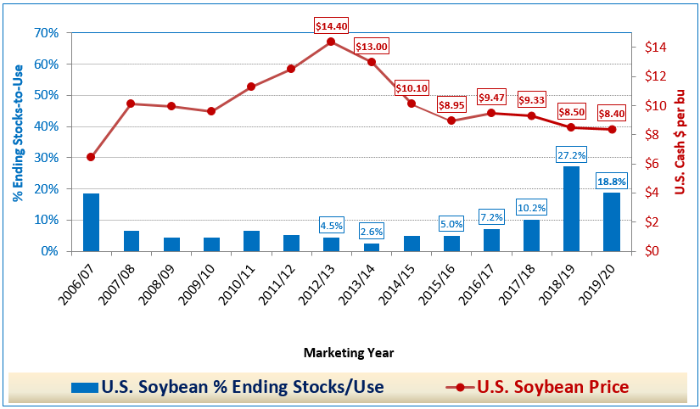
U.S. Soybean % Stocks/Use vs Price$
Notes:
Huge stocks in 2018/19 and predicted to remain high in 2019/2020
Price hovering right at the PLC reference price $8.40

Slide 32

What program should I choose?
PLC payments will be made if the MYA price drops below $8.40
PLC payment will exceed ARC-CO payments at any yield level if price drops below $7.43
With an average yield (33 bushels), ARC-CO will not start paying until price falls below $8.23
If the county yield is lower than average, ARC-CO will pay at much higher prices BUT if the county yield is higher than average, it will take a large price loss to trigger any payment
ARC-CO maximum payment will be $32.21 per acre in 2019
Notes:
Use the “Trade-Off” spreadsheet under Agent Resources to get your county/crop. You may have to duplicate this slide if you have irrigated and dryland acres of each commodity.
Change the numbers in RED to reflect what the table is telling you for your own county.
Payments are listed on a per acre basis
Keep in mind that these payments will only be made on 85% of the base acres that you have in that commodity. There may also be a budget sequestration on these payments (likely 6.2%)
Also, the program yield (in yellow) is actually your farm’s own established yield with FSA. Producers can use this spreadsheet themselves off of AgManager and put in their own program yield to more accurately evaluate the trade-off for their farm

Slide 33
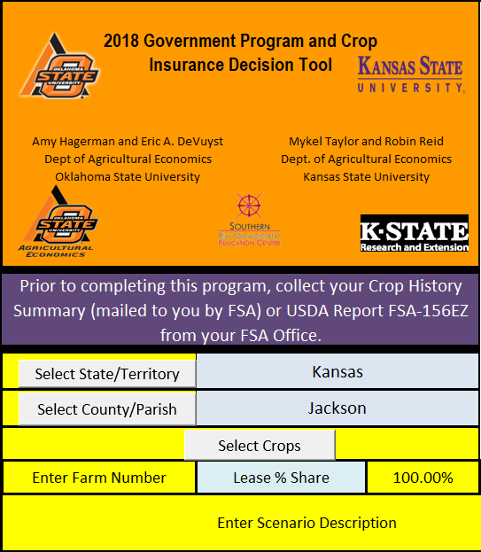
OSU-KSU Farm Bill Decision Tool
Can evaluate the 2-year ARC/PLC decision for each commodity on each individual farm
Can do scenario analysis for different price/yield levels
Also has ARC-IC and SCO program capabilities
Available soon at AgManager.info
Some counties will offer assistance in running this decision tool

Slide 34
Supplemental Coverage Option
SCO only available under PLC; cannot purchase if you are in ARC
An endorsement to your own farm policy (“underlying policy”)
Brings coverage up to 86% of expected yield/revenue
$$ coverage based on farm APH but loss trigger/measure based on county outcome
Must sign up prior to planting, like regular MPCI policy
SCO part of larger crop insurance decision
    Buy SCO -- or -- Buy higher individual coverage -- or -- Don’t buy any more insurance
    Few of the 2014-2018 acres in PLC also bought SCO

Slide 35
Conclusions and Implications
For the 2018 Farm Bill, it’s a 2-year decision, NOT a 5-year decision, as it was in 2014.
  What do you expect prices to be over the next two years?
    Prices lower than PLC reference prices will favor the PLC program
  What do you expect yields to be over the next two years?
    The ARC-CO program may be preferred if prices are above reference prices because lower yields can trigger payments
  Is SCO a consideration? (Nudges toward PLC)
Implication: be careful of making the decision based solely on the result of the last five years or feeling like you didn’t get it right in 2014.

Slide 36
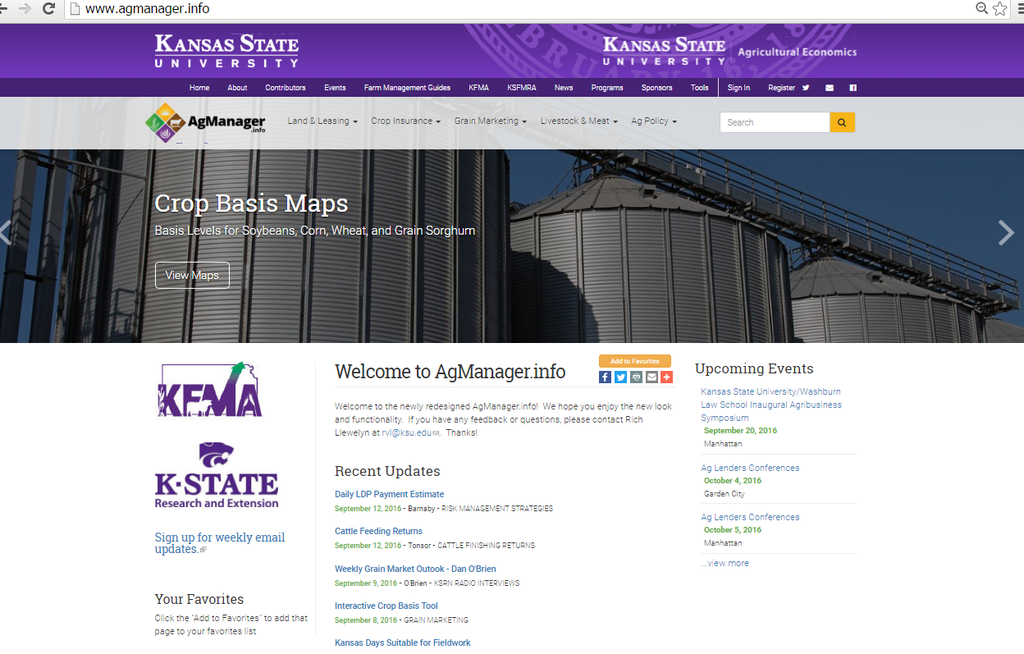
THANK YOU!
Agent Name
Email
Phone Number
Notes:
Add your contact information to this slide!

